Slide 1


Office of Nonproliferation and
Verification Research and Development
University Program Review (UPR) 2017 Meeting
MCLLS Analysis of Neutron Capture and Inelastic Scatter Gammas for Oil-Well Logging
June 8, 2017
Vincent DiNova, Graduate Student Researcher
North Carolina State University
June 6 - 8, 2017

Slide 2
Goals and Objectives
Goal: Development of new simulation, analysis, and modeling methods to accurately estimate porosity, lithology, and density for Oil-Well Logging tools
Objectives:
Develop iterative MCLLS algorithm to improve accuracy of analysis tools
Incorporate spiking method to aid in experiments being performed at NCSU and the testing facility at KSU
Generate library for the many scenarios of oil/water composition, mineral deposition, and detector responses

Slide 3
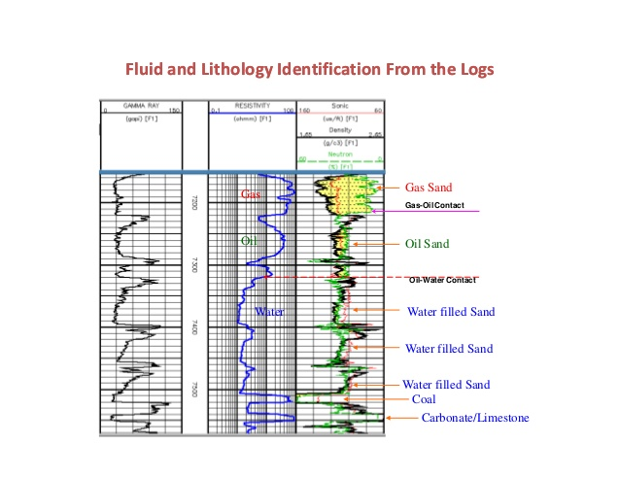
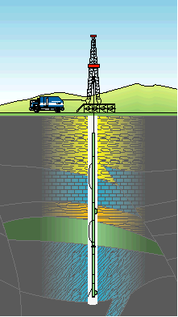
Source Replacement in Oil Well Logging Problem

Slide 4
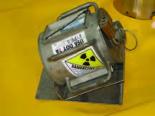
Sources
Existing tools use:
Cs-137
Long half life (~30.17 years)
Source activity 1-3 Ci
AmBe (or other neutron emitter)
Long half life > 400 years
Source activity 2-20 Ci
Replacement:
D-T generator (14.1 MeV neutrons)
Deuterium
Tritium
Helium
Neutron
2
H
+
3
H
4
H
+
1
n
+
17.6 MeV
1
1
2
0

Slide 5
Neutron Interactions
γ
INELASTIC SCATTERING
γ
THERMAL CAPTURE
NEUTRON ACTIVATION

Slide 6

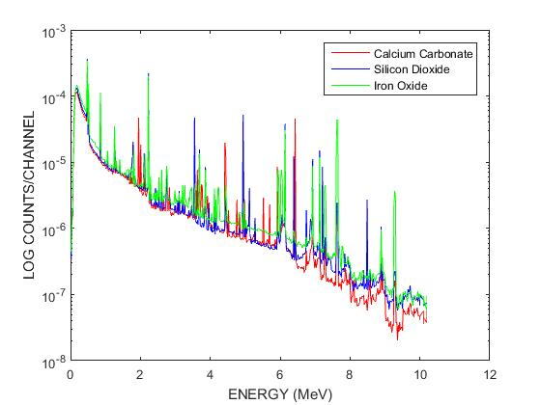
Sample Simulation of Tradition Oil Well Logging Tool

Slide 7
Detector Response Function Development (CEARDRF)
Inclusive DRF-Monte Carlo Code created to generate mono-energetic gamma ray detector responses for bare crystals
Added a second feature to flat continuum (Dr. Sood)
Compton edge was presumed by producing a very sharp change indicating a 180 degree Compton scatter event
CEARDRF included low-energy Doppler effect to produce shape that matches experimental results
Recent developments have added functionality of different detectors (NaI, BGO, LaBr)
Currently being used to correct unspread simulated data from CEARCPG or MCNP

Slide 8
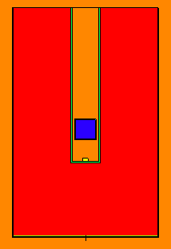
NCSU Spiking Experiment
Designed to test and improve DRF
Work in conjunction with tool designed at KSU

Slide 9
Iterative MCLLS Approaches
Early tests have demonstrated that the hydrogen content has a large nonlinear effect on the overall detection of neutrons and gamma rays
Generate libraries to match each water/crude content
Perform initial MCLLS search to estimate water/crude content
Pull libraries from matched water/crude content simulations
Perform MCLLS on remaining spectrum
Continue iterations until convergence criterion is met
Possibility of adding information from other tools (Resistivity) for improved initial guesses

Slide 10
Next Steps-All the fun!
Perform experiments at KSU and NCSU
Apply iterative MCLLS technique to determine lithology/porosity/density using the spiking technique
Incorporate uncertainty quantification propagation being designed at Georgia Tech to analysis methods
Determine if elemental vs. mineral composition yields provides more useful for analysis
Make changes to method as necessary from experimental results

Slide 11
References
A.Sood, R.P.Gardner / Nucl. Instr.and Meth.in Phys. Res.B 213 (2004) 100–104
R.P. Gardner, A.M. Yacout, J. Zhang, K. Verghese, Nucl. Instr. and Meth. A 242 (1986) 399.
R.L. Heath, Scintillation Spectrometry, Gamma-Ray Spectrum Catalogue, 2nd Ed., USAEC Report IDO-16880, 1964.
Y. Jin, R.P. Gardner, K. Verghese, Nucl. Instr. and Meth. A 242 (1986) 416.
A.M. Yacout, R.P. Gardner, K. Verghese, Nucl. Instr. And Meth. A 243 (1986) 121.
M. Geretschlager, Nucl. Instr. and Meth. B 28 (1987) 289.
T. Papp, J.L. Campbell, D. Varga, G. Kalinka, Nucl. Instr. and Meth. A 412 (1998) 109.
MCNP Training Manual
Serra, Oberto. Well Logging Handbook. Ed. Technip, Paris. 2008

